Slide 1
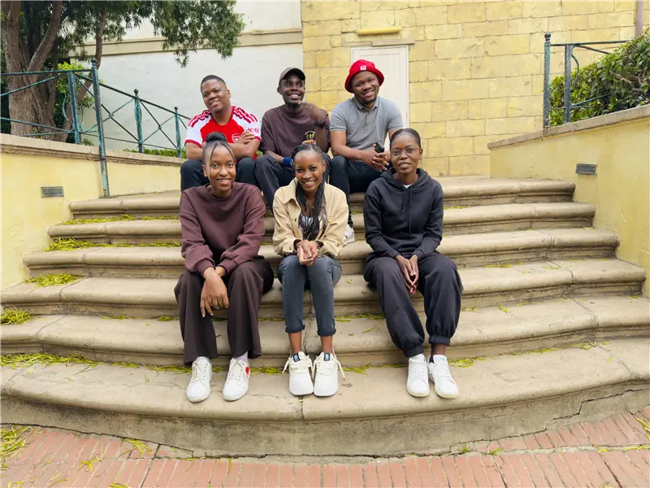
The Problem
We Are Solving
Slow SQL queries are difficult
and time-consuming to optimize.
Our solution: SQL Optimization Workbench
The Data Minds • Final Demonstration
Notes:
Opening: The problem we are solving is slow SQL queries and the time required to optimize them. When a query is slow, we often have to investigate it, try rewrites, run those rewrites and compare the results. The challenge is that a rewrite that looks better is not necessarily faster on the real database. We built the SQL Optimization Workbench to address that problem. Move quickly to the next slide.

Slide 2
The problem we are solving
Why is SQL optimization difficult to validate?
The manual process
Slow query → Investigate → Rewrite → Test → Compare → Decide
Time and effort
Uncertain rewrites
Need for evidence
Finding the cause of poor query performance
can require significant manual investigation.
A query rewrite that looks better is not
necessarily faster on the actual database.
Teams need measured results, not
suggestions alone to support the
optimization decision.
The challenge: prove that the change actually improves performance.
The Data Minds • SQL Optimization Workbench | 2
Notes:
SQL tuning is often a manual process. It consumes specialist effort, and suggestions alone are not enough. We need a way to test alternatives and produce measurable evidence. Keep this explanation under one minute.

Slide 3
Our solution
SQL Optimization Workbench
Test optimization candidates against a measured baseline.
01
02
03
04
05
06
Query
Baseline
Candidates
Test
Compare
Recommend
Measure
Compare
Explain
Establish the original query as the control.
Run candidates and identify the best observed result.
Show what changed and why it is worth reviewing.
The Data Minds • SQL Optimization Workbench | 3
Notes:
The workbench establishes the original query as a baseline, generates candidate alternatives, tests them repeatedly, compares the results and presents the best observed result. The goal is to shorten the path from a slow query to an evidence-backed decision.

Slide 4
Let's see it in action
Live demonstration: from query to measured result
1. Connect
2. Load
3. Run
4. Optimize
5. Review
Demo SQLite
Schema + indexes
Original query
Test candidates
Compare results
What we watch
What we can explain
Baseline execution time
Candidate execution time
Best observed result
Original vs. optimized SQL
Performance history
Plan signals where available
The Data Minds • SQL Optimization Workbench | 4
Notes:
Live demo: Start with Demo SQLite, load the schema, show the original query, explain briefly what makes it inefficient, run optimization, show candidates being tested, then show the final result. Do not explain every backend feature while the demo is running.

Slide 5
Did we actually improve the query?
The decision is based on observed performance evidence.
Baseline
Best observed
Improvement
Original execution time
Fastest successful candidate
Change versus baseline
Performance history
SQL comparison
Show the actual runs from the live demo.
Use the chart to explain consistency and identify outliers.
Original versus optimized SQL.
Plan signals
Cost, rows, scans, sorts and disk reads where available.
The Data Minds • SQL Optimization Workbench | 5
Notes:
Use the actual values from the live run. Point out baseline, best observed execution time, improvement, SQL comparison and relevant plan signals. Say: The important point is that the system measured the candidates rather than assuming a rewrite would be faster.

Slide 6
Why this matters
• Faster investigation of slow queries
• Evidence-based optimization decisions
• Explainable SQL changes for engineering review
We are not replacing the engineer.
We are making optimization faster, measurable and easier to
validate.
Questions?
The Data Minds • SQL Optimization Workbench | 6
Notes:
Close: The value is faster investigation, evidence-based decisions and explainable changes. We are not replacing the DBA or engineer; we are making optimization faster, measurable and easier to validate. Then invite questions.

